Slide 1

Magical Thinking
(Mine, Yours and Ours)
Martin Geddes

Slide 2
THERE…

Slide 3
MY PERSONAL JOURNEY…

Slide 4
MY PERSONAL JOURNEY…
…AND BACK

Slide 5
MY PERSONAL JOURNEY…
…OUR WORLD OF COMMS

Slide 6
Truth
Belief

Slide 7
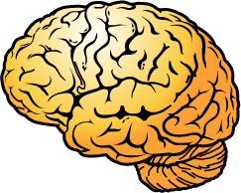
Belief

Slide 8
Truth

Slide 9
Magical Thinking
Truth
Belief
Unthinkable truths

Slide 10
MY PERSONAL JOURNEY…
BIRTH

Slide 11
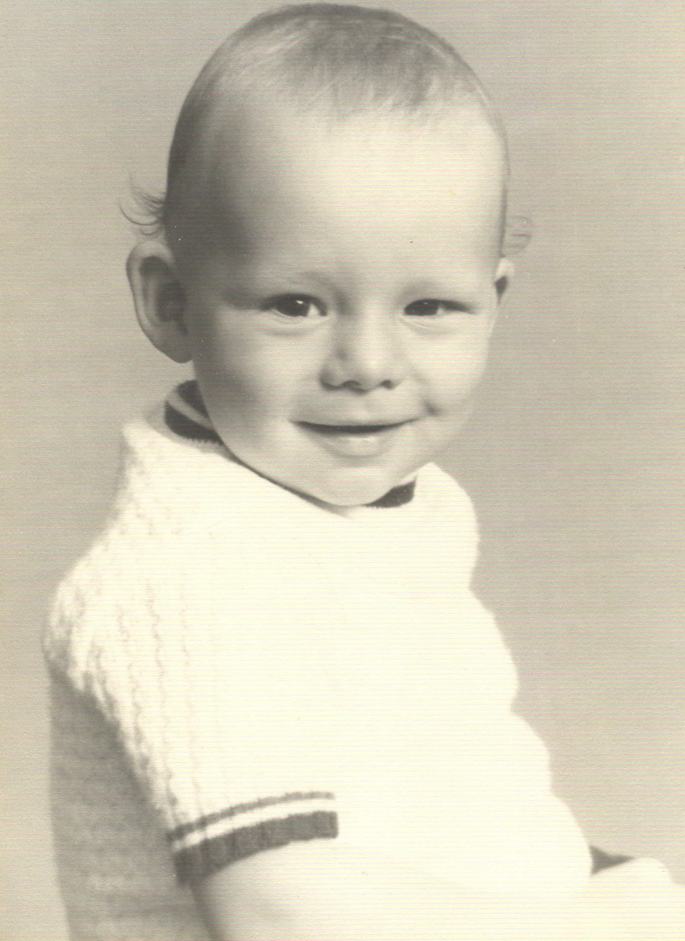

Slide 12
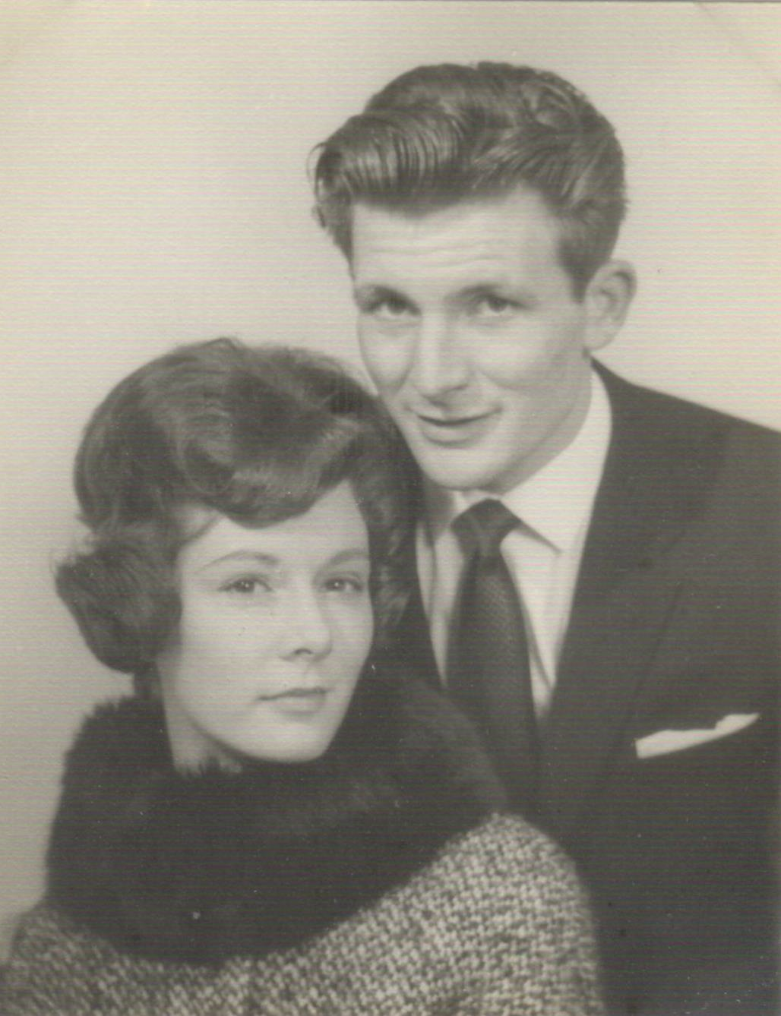

Slide 13
Having a baby will bring us together…

Slide 14
MY PERSONAL JOURNEY…
RELIGION

Slide 15
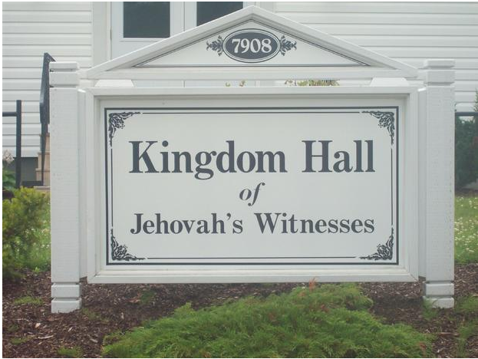

Slide 16
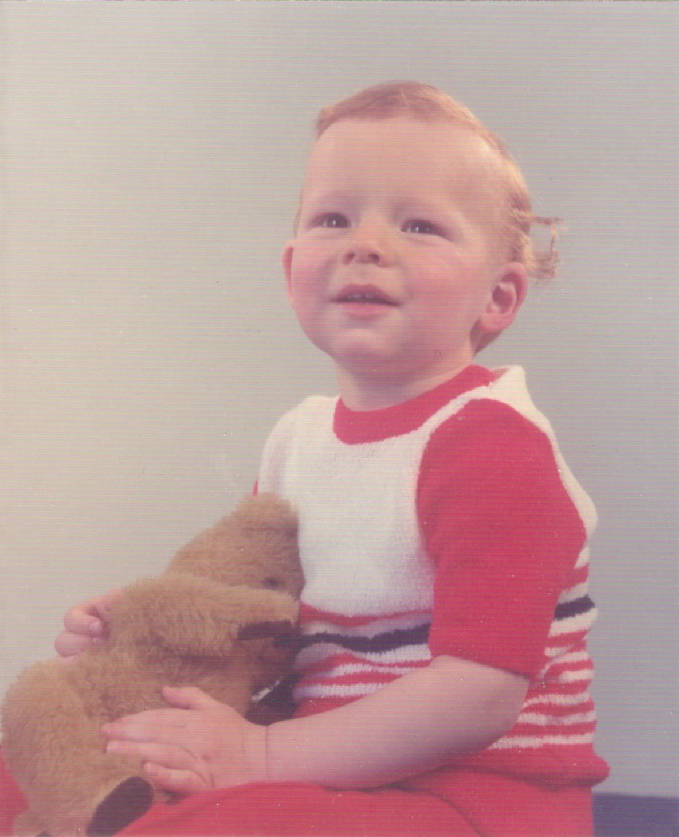

Slide 17
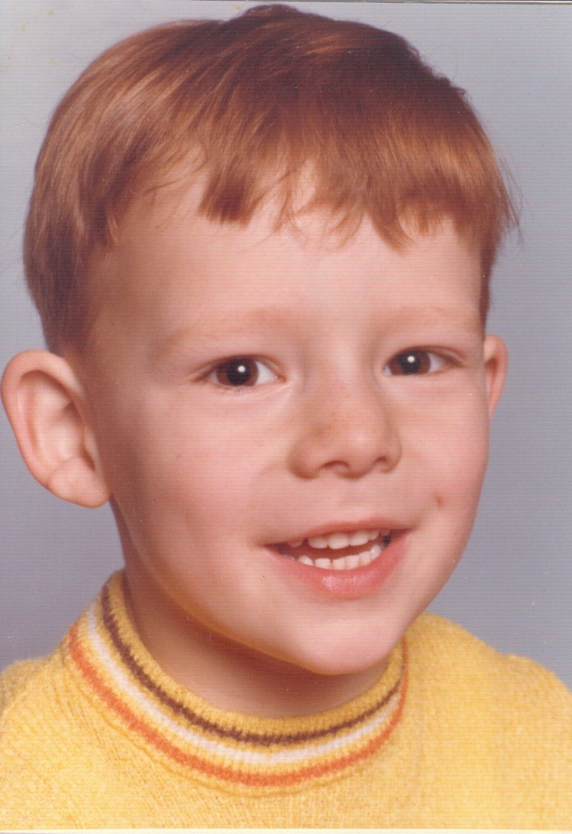

Slide 18
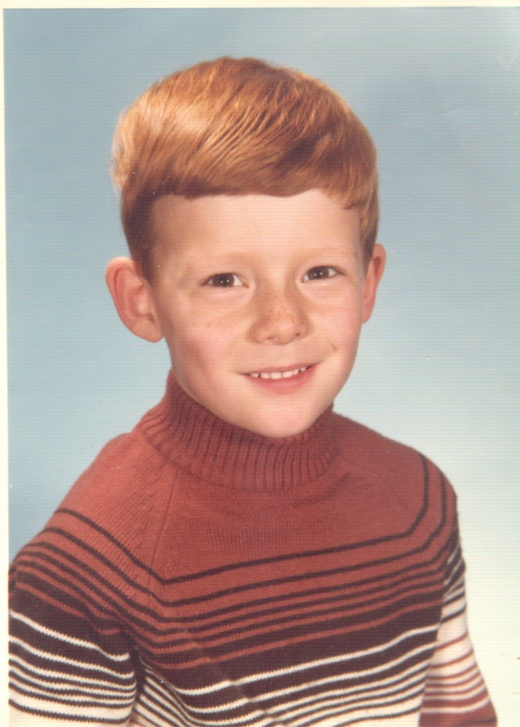

Slide 19

“The Truth”

Slide 20
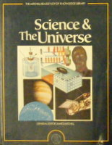


Slide 21
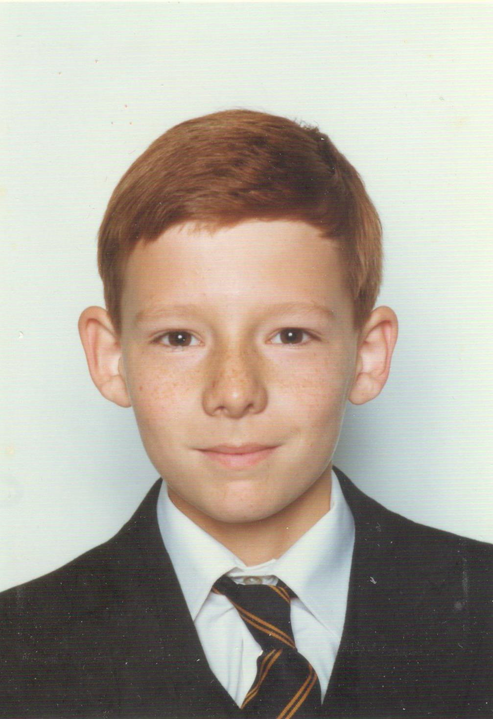

Slide 22
There is a perfect truth that comes from absolute belief

Slide 23
1
There is no single source of truth

Slide 24
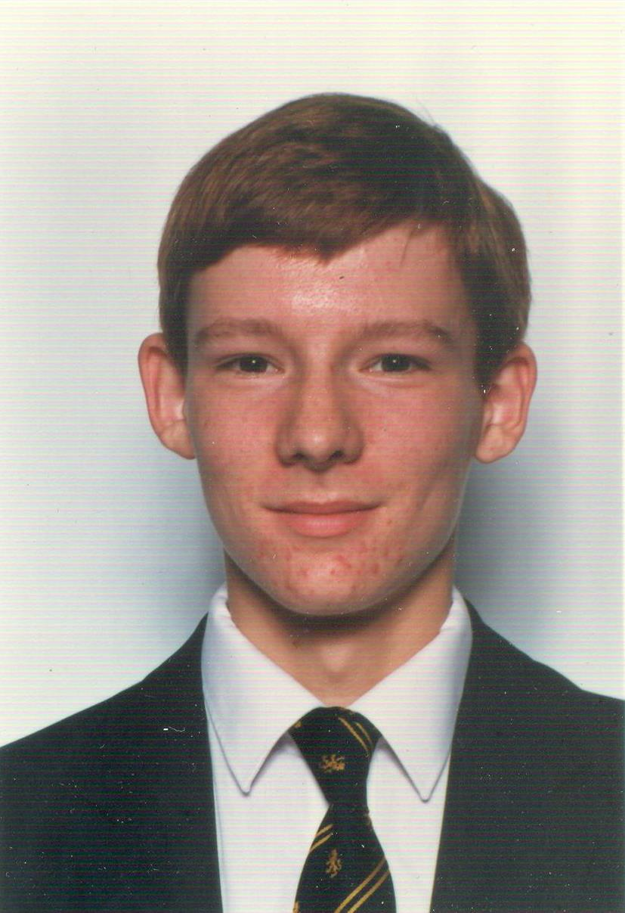

Slide 25
MY PERSONAL JOURNEY…
EDUCATION

Slide 26
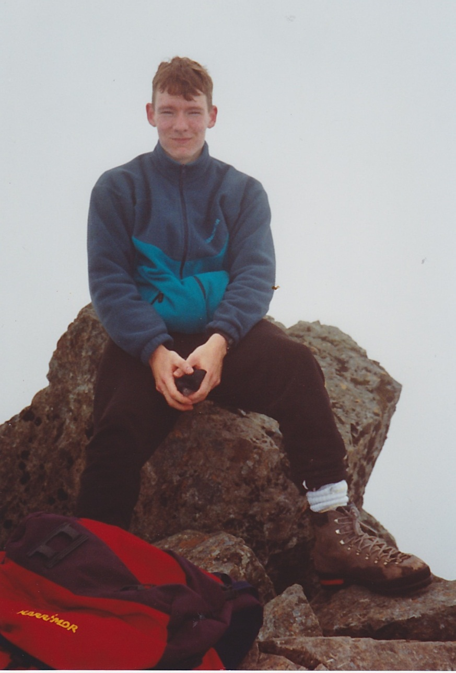

Slide 27
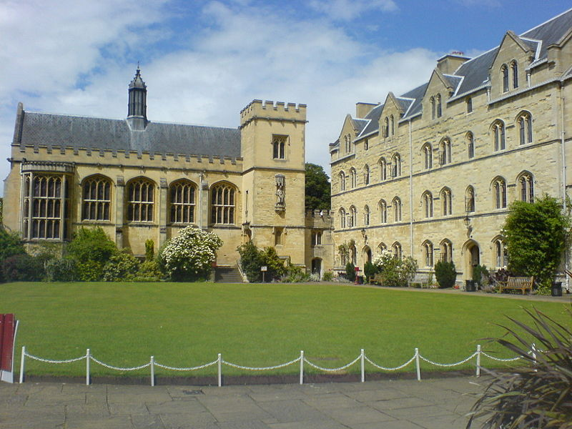

Slide 28
There is a ‘physics of people’

Slide 29
2
The most important truths are about people

Slide 30
MY PERSONAL JOURNEY…
WORK

Slide 31
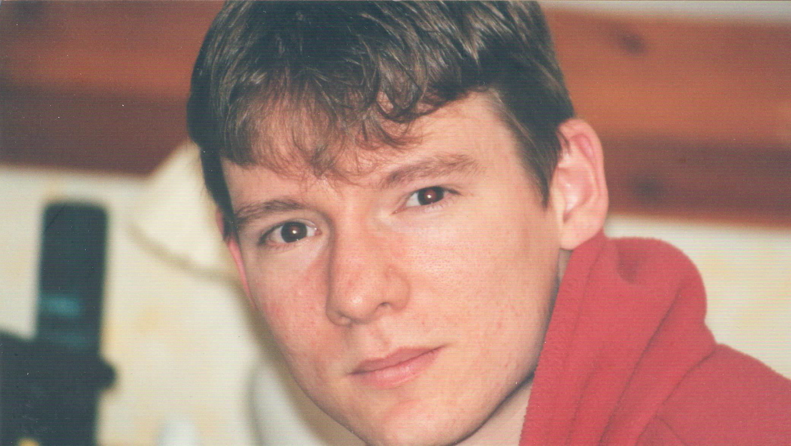

Slide 32


Slide 33
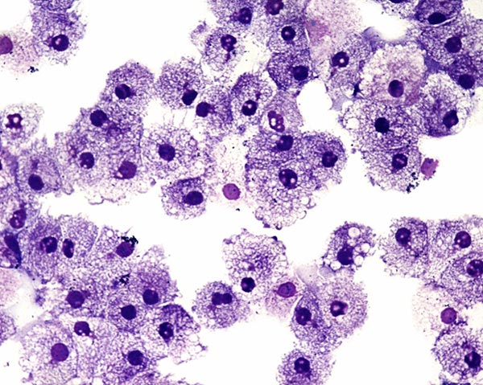

Slide 34
Those in ‘leadership’ have special access to truth

Slide 35
3
Truth can be lonely

Slide 36
MY PERSONAL JOURNEY…
IDENTITY

Slide 37


Slide 38
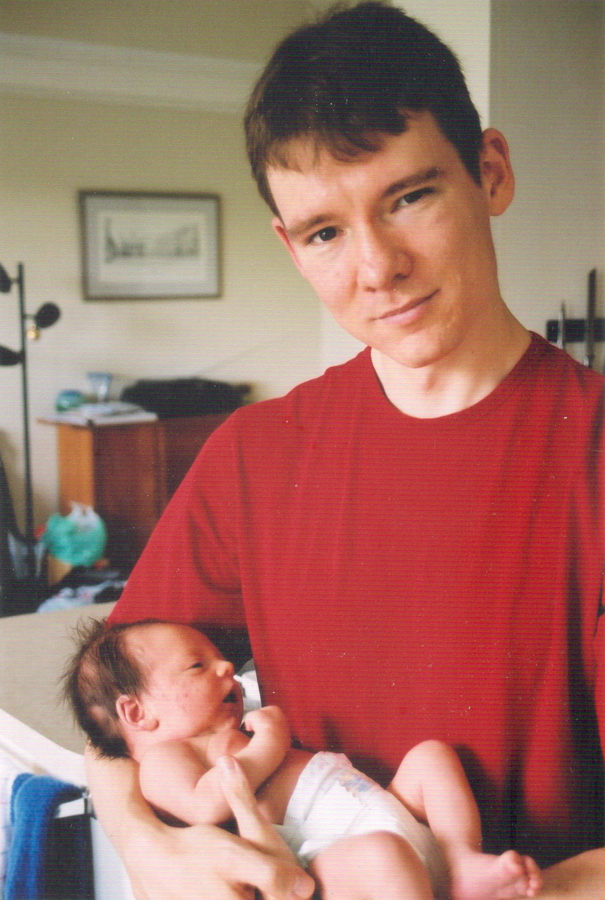

Slide 39
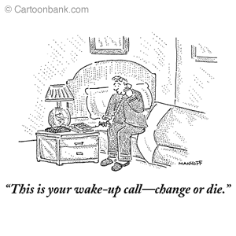

Slide 40
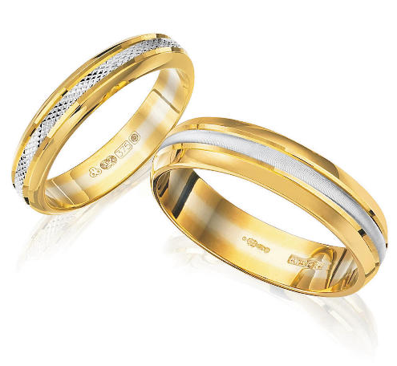

=

Slide 41
4
Truth is not static

Slide 42
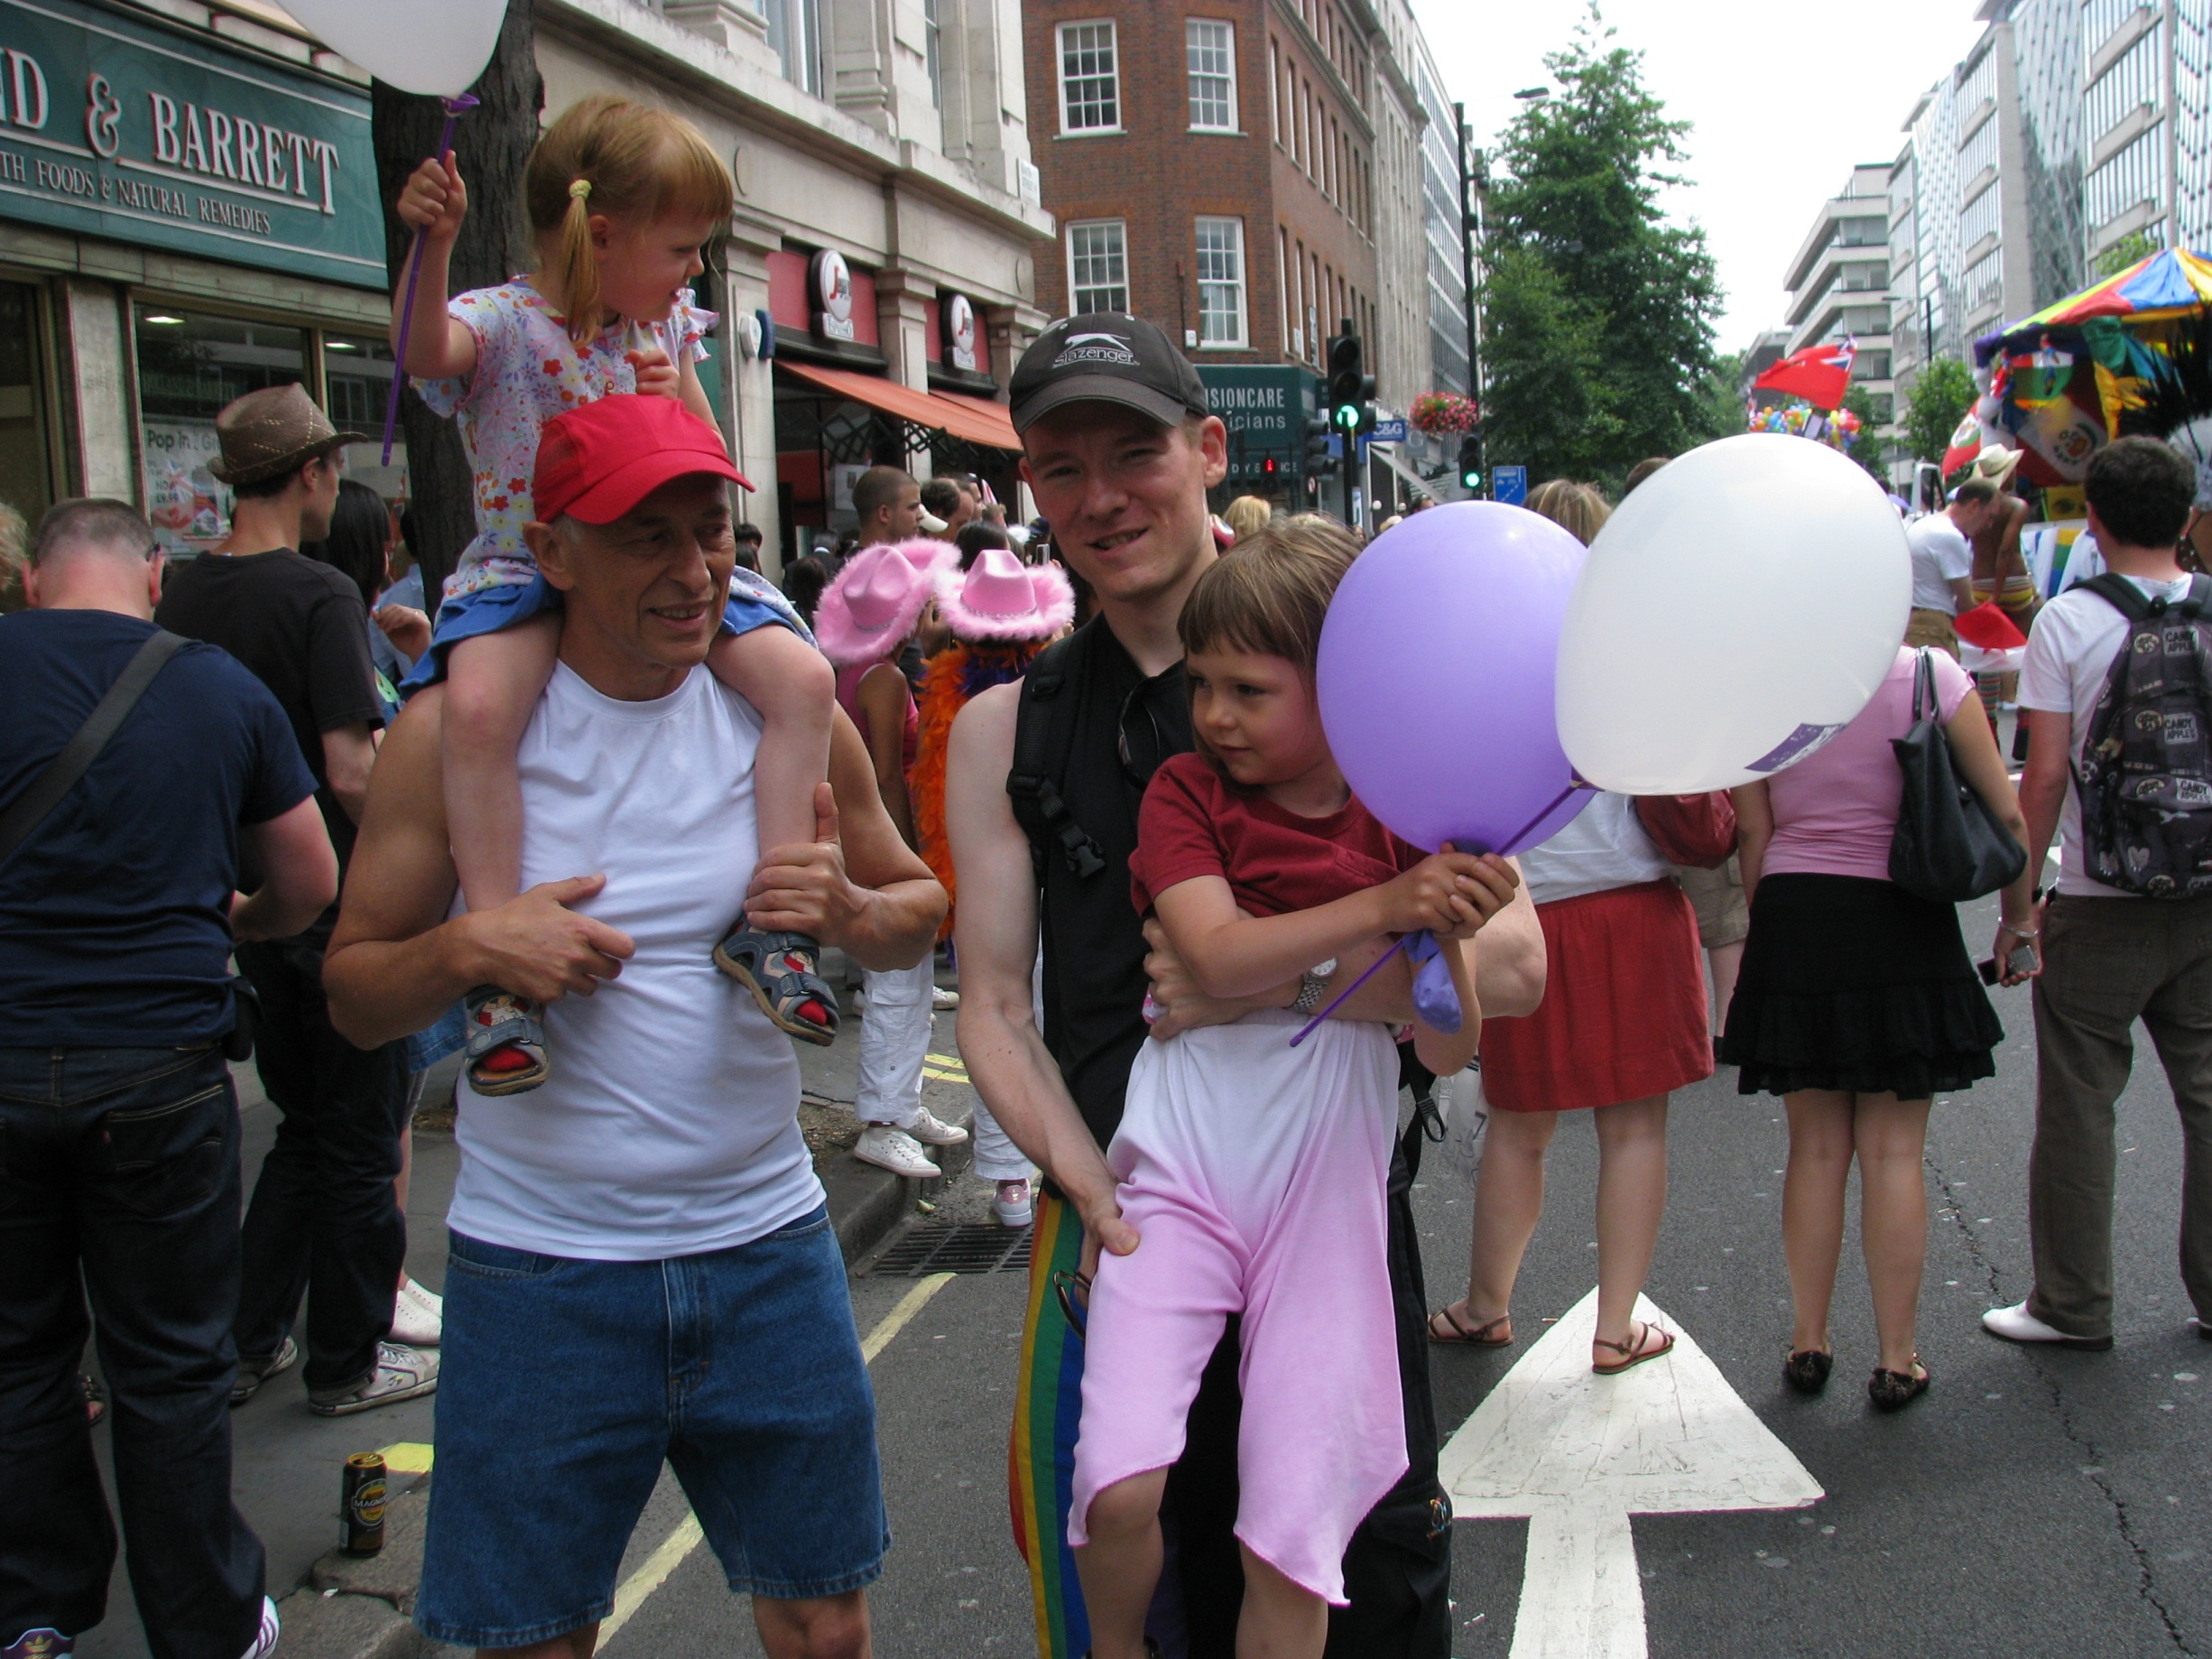

Slide 43
…OUR WORLD OF COMMS

Slide 44
4
Truth is not static

Slide 45
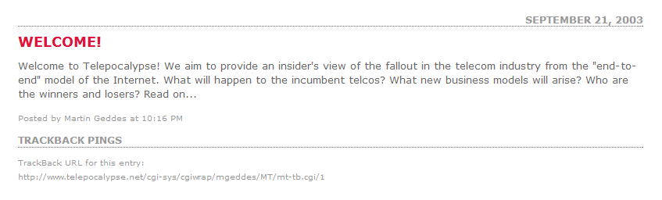

Slide 46
Vertical = bad; horizontal (and open) is always best

Slide 47

Truth? It depends

Slide 48
3
Truth can be lonely

Slide 49
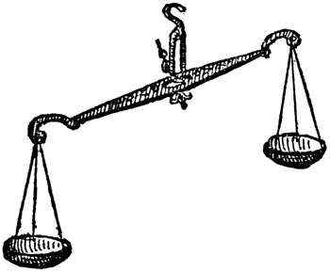
THE VERY Queer future of networks
EFFICIENCY
GENERATIVITY

Slide 50
Three kinds of network
Network of
Possibilities
Network of
Probabilities
Network of
Promises
Manage packets
priority, control loops
Manage flow, contention
and trade loss/delay
Manage sessions,
admission
and capacity

Slide 51
The only answer is ‘fatter pipes’ (as they aren’t pipes)

Slide 52
Truth? You can have it all!
EFFICIENCY
GENERATIVITY
DETERMINISTIC

Slide 53
2
The important truths are about people

Slide 54


Slide 55
Open networks means open services and societies

Slide 56
Truth? Power moves around
ENTERPRISES
PUBLIC

Slide 57
1
There is no single bearer of truth

Slide 58
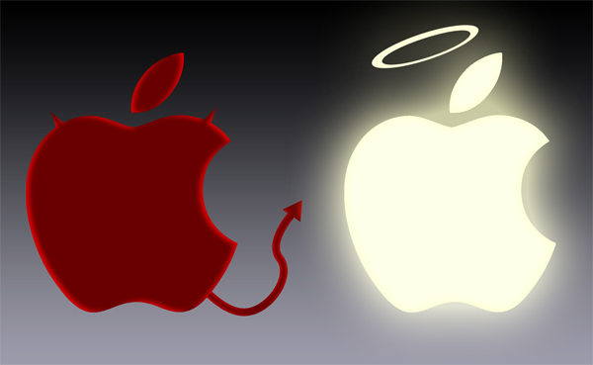
http://loganlape.wordpress.com/

Slide 59
The edge has your best interests in mind

Slide 60







Truth?
Power in distribution can move
vs.

Slide 61
0
And you?
Truth
Belief

