Slide 1
Fukushima Questions

Slide 2
How far is Fukushima from Tokyo?

Slide 3
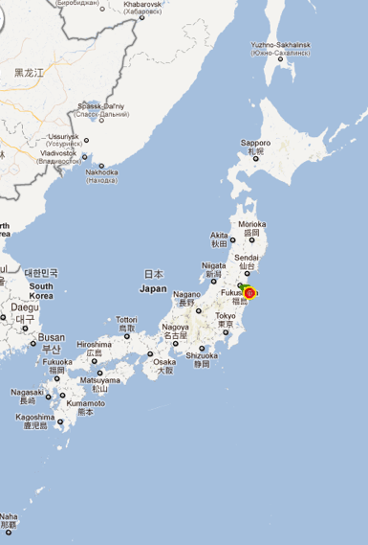
← Fukushima nuclear
power plant
↑Tokyo

Slide 4
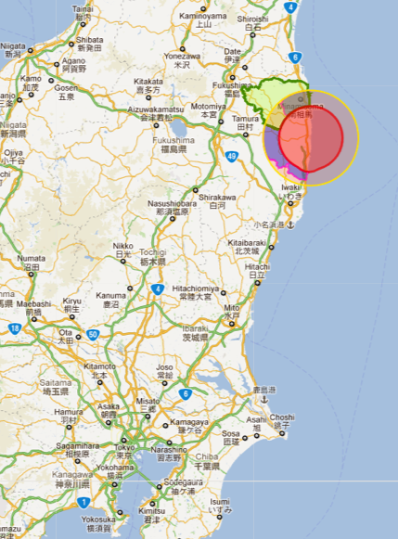
← Fukushima nuclear
power plant
２５０ｋｍ
←Tokyo

Slide 5
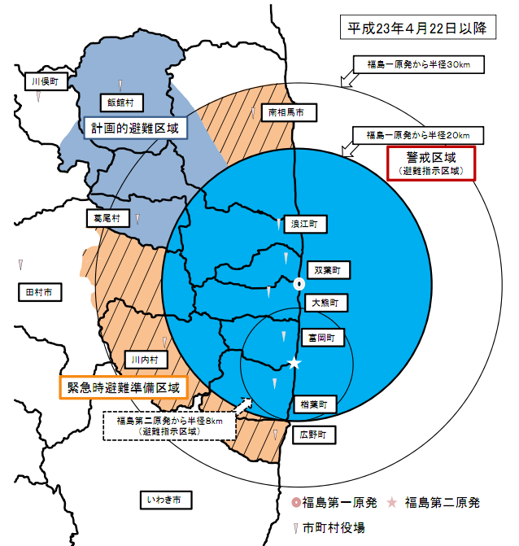
←20km
alert area
(may not go in)

Slide 6
← Planned evacuation area
← Emergency preparation area

Slide 7
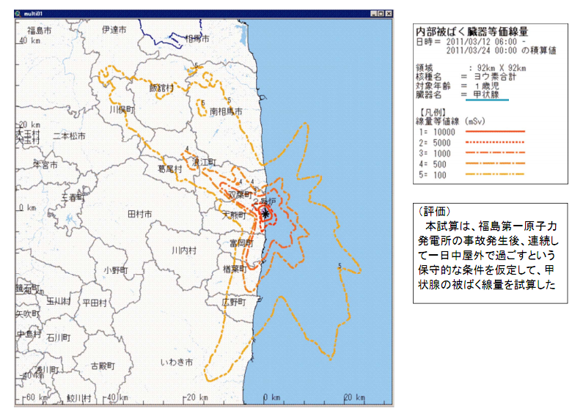
Data from SPEEDI
http://www.bousai.ne.jp/vis/torikumi/index0301.html
Ministry of Education,Culture,Sports,Science & Technology in Japan

Slide 8
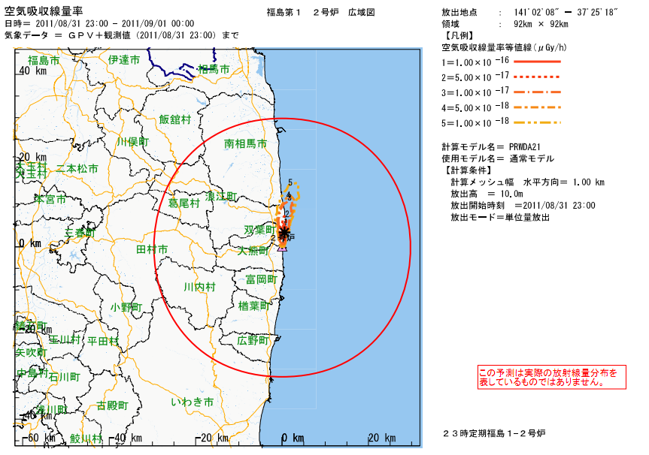

Slide 9
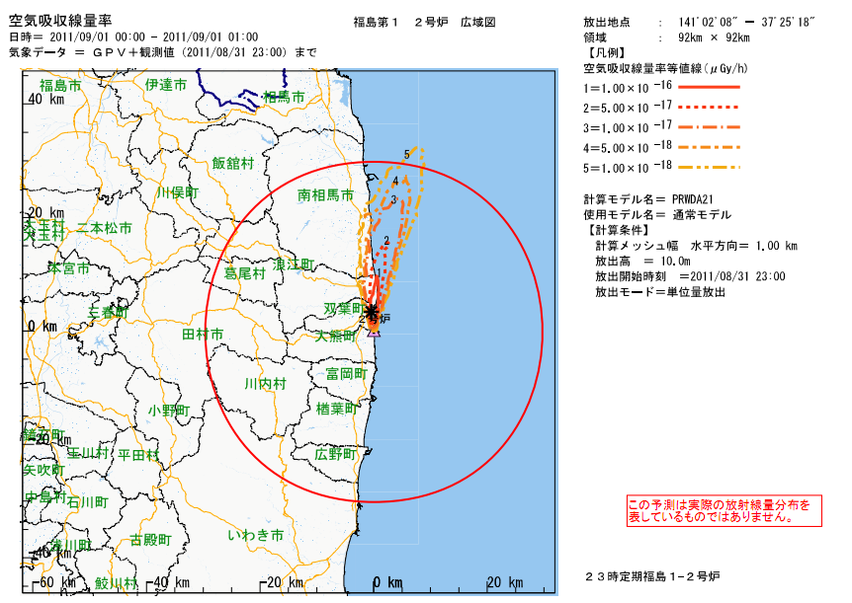

Slide 10
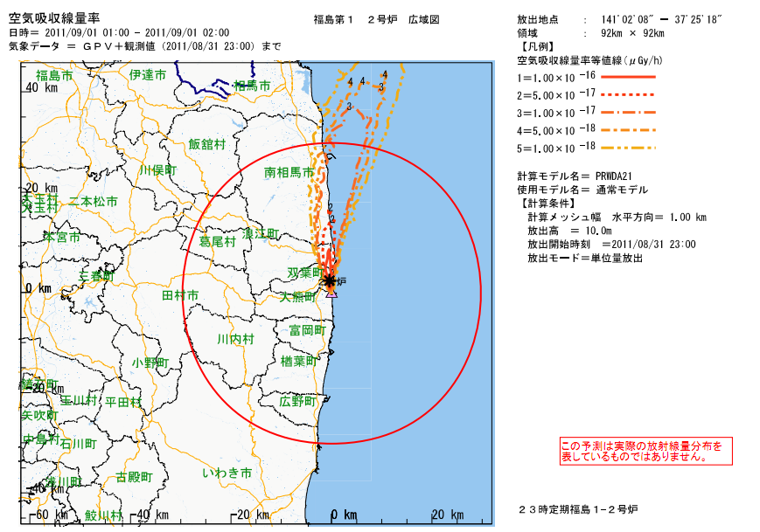

Slide 11
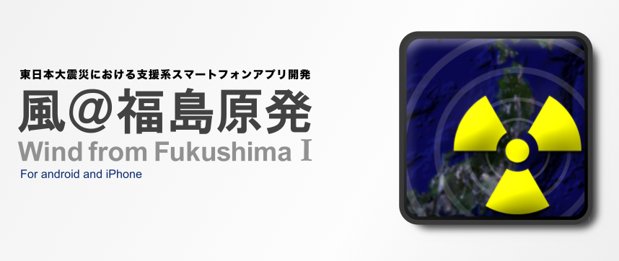
https://market.android.com/details?id=jp.gr.java_conf.seigo.stop_ra

Slide 12
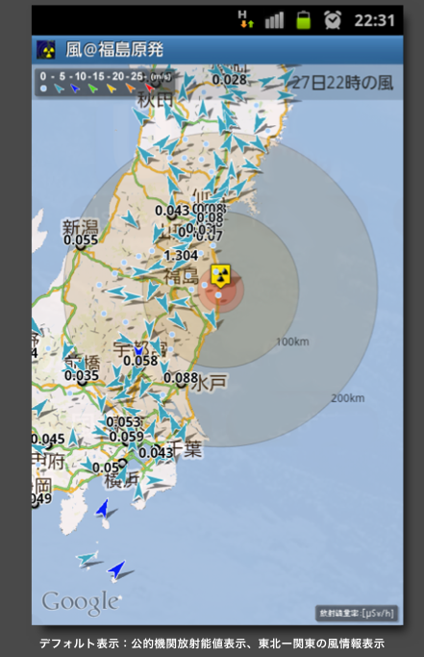
●Mapping
Distance from the nuclear PP
Radiation data from government
Radiation data from citizens
Wind direction / wind speed
●Information
Quake related info
Emergency buzzer
Flashlight
Powersaving function
Etc.

Slide 13
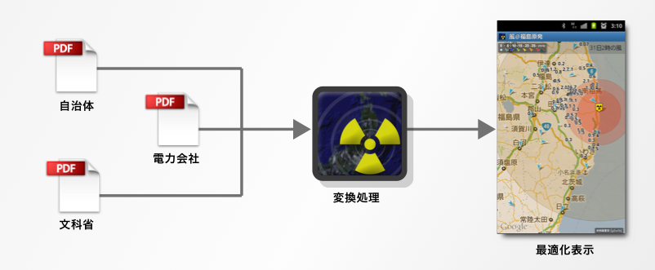
Local
government
Power
company
Ministry

Slide 14
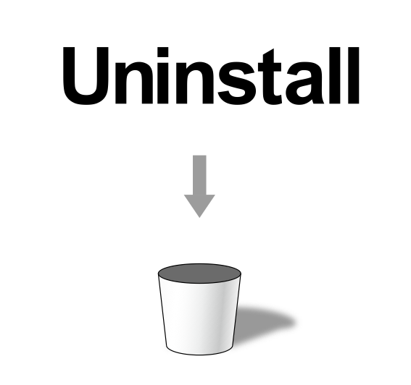

Slide 15
DIY, Open Source
Geiger Counters?

Slide 16
STEP1) Get data
→ buy or create geiger counter
STEP2) Get data online
→ fetch the data and post it online
STEP3) Visualize
→ mapping

Slide 17
STEP1) Get data
→ create open source geiger counters

Slide 18
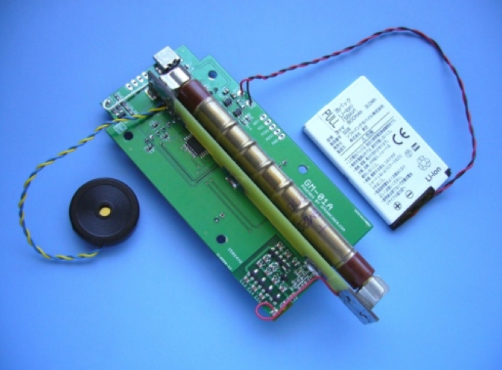
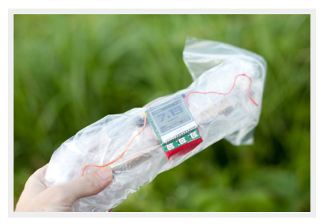
Open Geiger Project
http://opengeiger.com/

Slide 19
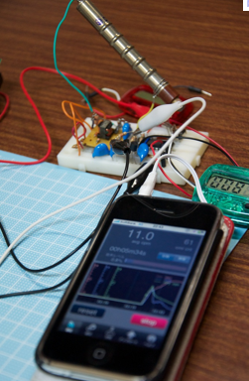
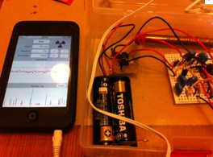
Open Force Geiger project
http://openforce.project2108.com/

Slide 20
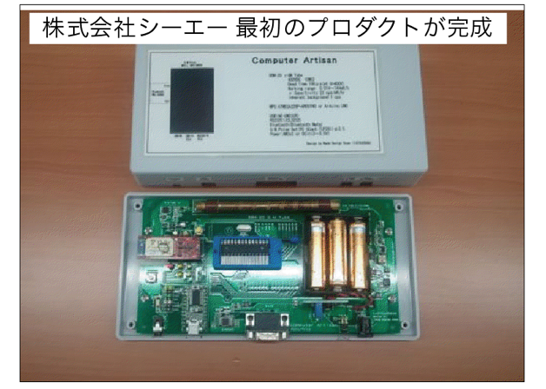
Companies productize
geiger counter

Slide 21
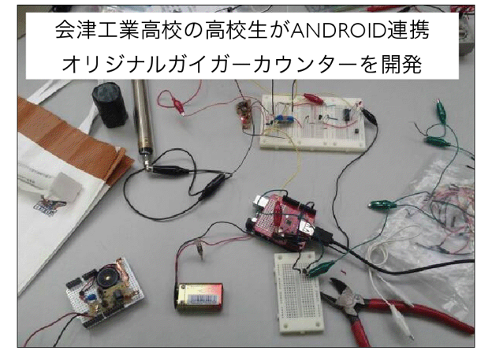
A HighSchool student makes
an original geiger counter

Slide 22
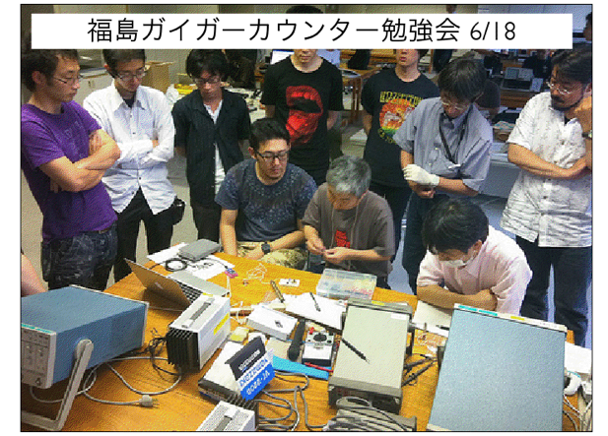
Geiger counter study group

Slide 23
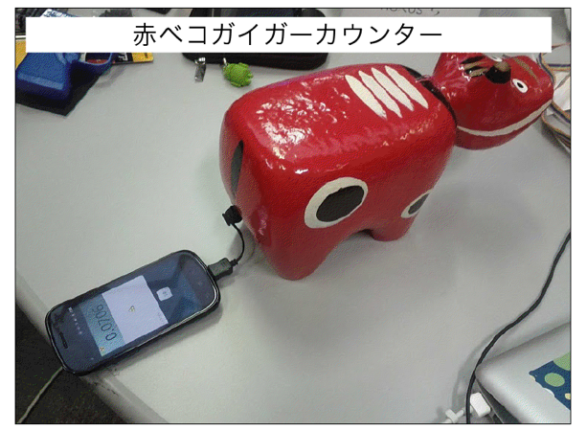
Akabeko Geiger counter

Slide 24
STEP2) Get data online
→ fetch the data and post it online

Slide 25
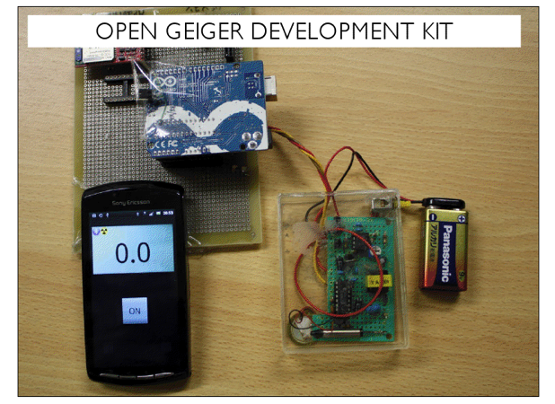
Open Source and Open Hardware Geiger Counter Project
http://code.google.com/p/open-geiger-development-kit/

Slide 26
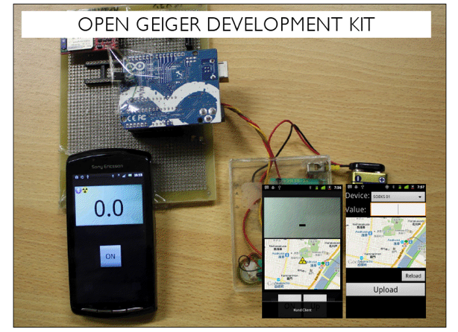

Slide 27
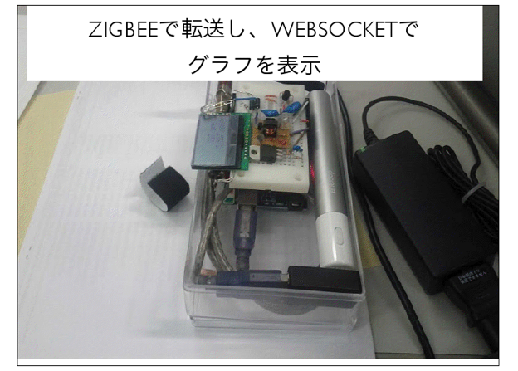
Transmit the data using Zigbee
and draw the chart using WebSocket

Slide 28
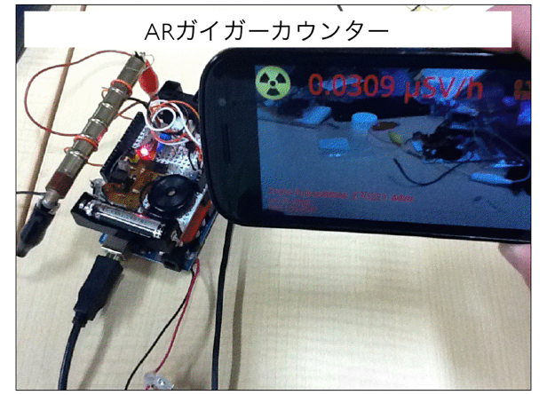
AR (augmented reality) Geiger counter

Slide 29
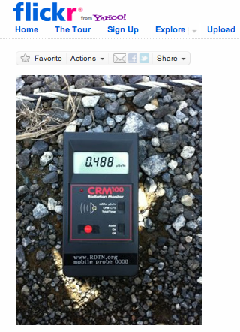
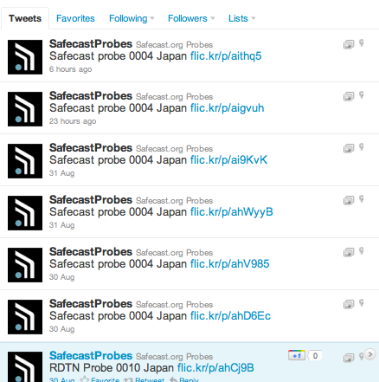
Safecast

Slide 30
STEP3) Visualize
→ mapping

Slide 31
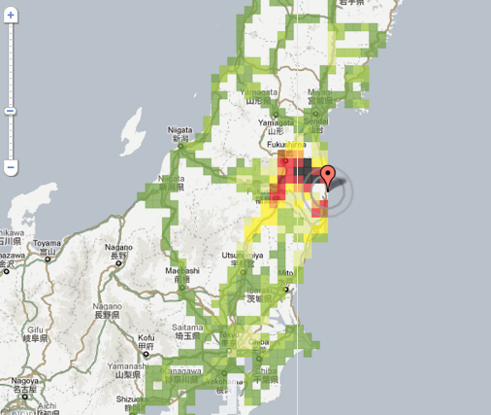
Safecast
http://maps.safecast.org/

Slide 32
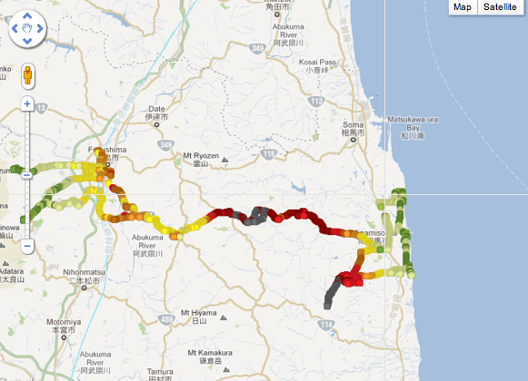
Safecast driving map
http://maps.safecast.org/

Slide 33
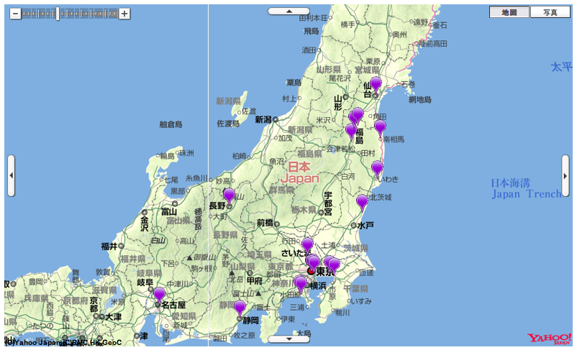
Yahoo Radioactivity map
http://maps.safecast.org/

Slide 34
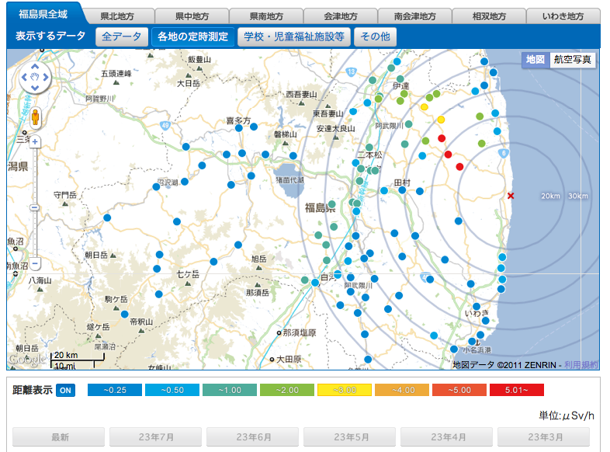
Fukushima Radioactivity Map
http://fukushima-radioactivity.jp/

Slide 35
Thanks!

Slide 36
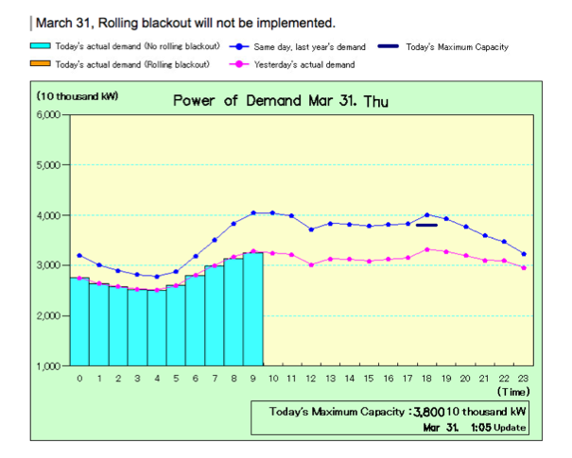

Slide 37
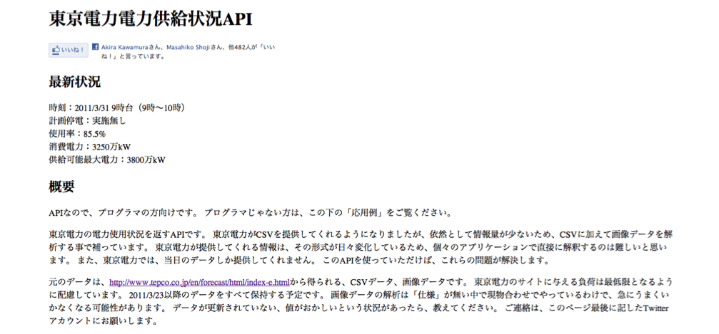

Slide 38
